Slide 1





CTX: Eliminating BREACH with Context Hiding
Dimitris Karakostas
Aggelos Kiayias
Eva Sarafianou
Dionysis Zindros

Slide 2
Who are we?
Dimitris Karakostas, Eva Sarafianou, Dionysis Zindros
Researchers at Security & Cryptography lab
University of Athens, Greece
Aggelos Kiayias
Chair in Cyber Security and Privacy
University of Edinburgh, Scotland

Slide 3
HTTPS is broken
BREACH broke HTTPS + RC4 in 2013
People upgraded to AES – thought they were safe
Rupture attacked HTTPS with block ciphers
Today...
We show a generic defense for compression side-channel attacks
Best balance between compression and security
We launch an open source implementation of the defense for popular web frameworks

Slide 4
Overview
Introduction
History
Attack vectors
The CTX defense
Origins, Secrets, Cross compression
Permutations
CTX architecture
Release
Future work

Slide 5
CRIME, 2012
Targets HTTPS requests
Side-channel compression attacks against TLS first-time successful
Τakes advantage of the characteristics of the DEFLATE algorithm
Hinted at attacking responses
Mitigated by disabling compression at the TLS level

Slide 6
TIME, 2013
Exploits compression on HTTP responses
Exploits compression by measuring time transmission
No need for permanent Man-in-the-Middle agents

Slide 7
BREACH, 2013
Exploits compression on HTTP response body
Attacks stream ciphers
Adds methods for bypassing compression noise

Slide 8
RC4 insecurity, 2015
RC4 is considered insecure
Most websites use block ciphers
AES is the industry standard

Slide 9
Rupture, 2016
Exploits compression on HTTP responses
Performs statistical analysis
Bypasses noise/length hiding
Attacks block ciphers, eg AES
Automates the attack process
Production code

Slide 10
HEIST, 2016
No need for Man-in-the-Middle agents to perform BREACH
Abuses the way responses are sent at the TCP level

Slide 11
Attack methodology
Compression is better across same content
Example: “test_test” compresses better than “test_rand”
Method
Target an HTTPS website
Find a web page that:
Allows parameter reflection
Contains a secret
Issue requests with different reflections using the victim’s cookies
Measure the responses’ lengths
Decrypt the secret using statistical analysis

Slide 12
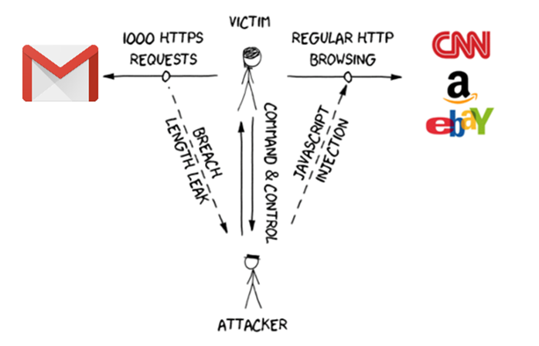

Slide 13
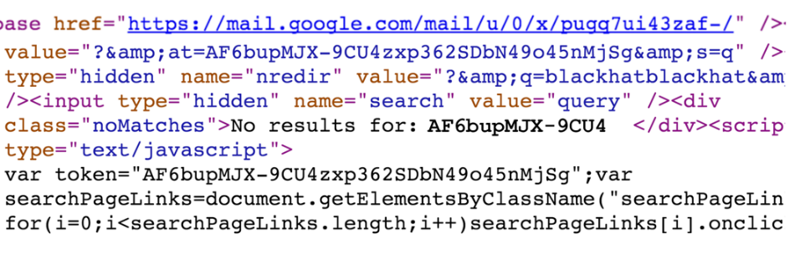


Attacker guesses part of secret
Uses it in reflection
Compressed/encrypted response is shorter if right!
Reflection
Secret

Slide 14
The CTX defense

Slide 15
CTX, Context Transformation Extension
Context hiding in a per-origin manner
to separate secrets and avoid cross-compression

Slide 16
Origin
Party that generated the secret
Web application
User
Secrets of the same origin → Cross-compression
Secrets of different origin → Separate compression

Slide 17
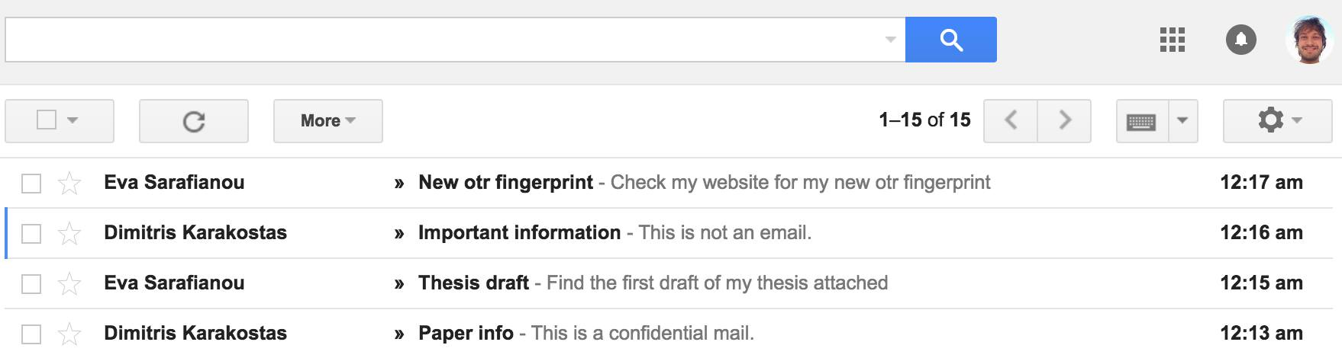

Slide 18
Secret
Parts of the response
CSRF tokens
Private messages
E-mails
Financial data
Any piece of information which is only accessible when logged in

Slide 20
OK to compress together

Slide 21
NOT OK to compress together!

Slide 22
Cross-compression
Cross-compression between “a”, “b” → Presence of “a” affects compression of “b”
Example:
LZ77 compression
Plaintext: a + b
a = “secret1”, b = “secret2”
Cross-compression:
C(a) = “secret1”, C(b) = (7, 6) + “2”
Separate compression:
C(a) = “secret1”, C(b) = “secret2”

Slide 23
How can we protect secrets?
Disable compression ✗
Unacceptable performance penalty
Change the compression function ✗
All good compression functions are vulnerable
Modify the web server compression module ✗
Requires changing both the web server & application
Hard to achieve good compression rate
Hide length with random padding (TLS 1.3) ✗
Susceptible alignment + statistical analysis (Rupture)
Change the response plaintext ✓

Slide 24
CTX, Context Transformation Extension
Protects HTTPS responses
Runs at the application layer
Is opt-in
Balances between performance and security
Slight compression size increase
Small time performance overhead
Fully prevents complete plaintext recovery
Successful defense for all known compression attacks
(TIME, CRIME, BREACH etc)

Slide 25
CTX, Context Transformation Extension
Application developer must do the following:
Import ctx library server-side ( Django, Flask, Node.js … )
Import ctx library client-side ( <script src=”ctx.js”></script> )
Select sensitive secrets
Define origin for each secret

Slide 26
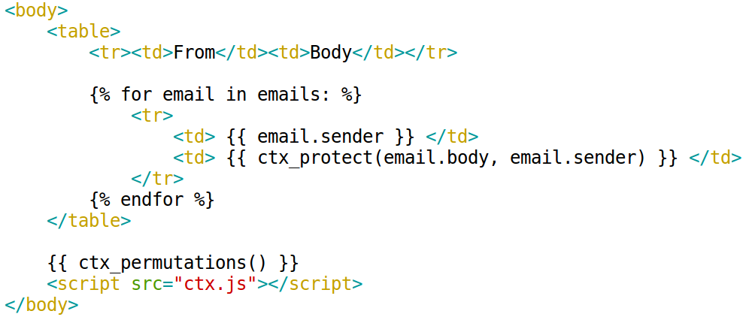

Slide 27
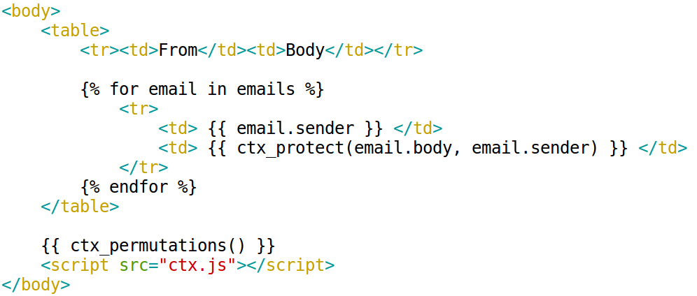
Secret Origin

Slide 28
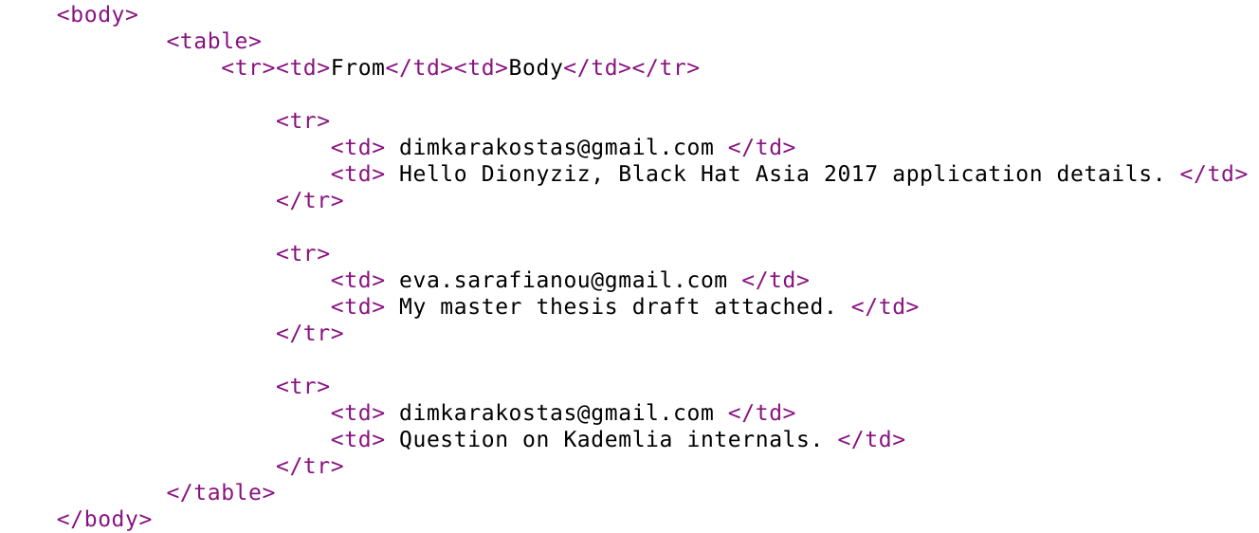

Slide 29
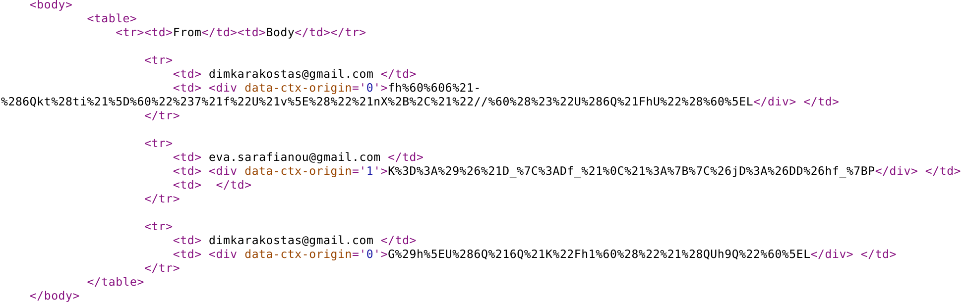

Slide 30
Permutations
Define secret alphabet
Contains all possible characters in the secret
e.g. ASCII, UTF-8
Pseudo-random permutation of the secret alphabet for each origin
Fisher-Yates shuffle algorithm
Permute secrets using the origin’s permutation
TLS encryption and network transmission of the permuted secret
Apply inverse permutation → Decode the secret

Slide 31
Secret | Origin | Permuted secret
secret1 | origin1 | )o5eoc8
secret2 | origin1 | )o5eock
secret3 | origin2 | heb^eV#
Origin | Permutation
origin1 | s → ) e → o c → 5 r → e t → c 1 → 8 2 → k 3 → # (...)
origin2 | s → h e → e c → b r → ^ t → V 1 → g 2 → ! 3 → # (...)

Slide 32
Attack mitigated
New per-origin permutations per HTTP response
Multiple responses contain differently permuted secrets
Permutations cannot be statistically predicted

Slide 33
Performance experiments
We test size/time performance under CTX
Test web page:
650KB (e.g. YouTube timeline)
50 origins
1% secrets in the response equally distributed in origins
1 secret position per origin

Slide 34
Performance experiments
Results:
Disable total compression:
1,100% size overhead
Few seconds time delay during transmission
Masking secrets:
21% size overhead
CTX:
5% size overhead ~ 7KB
4ms time delay

Slide 35
Performance experiments
Origins ↑ → Performance ↓
Total secrets ↑ → Performance ↓
Secrets per origin ↑ → Performance ↑
Total response ↑ → Performance ↑

Slide 36
Total response performance
Bigger response:
Similar byte size overhead
Better percentage size overhead

Slide 38
CTX Architecture

Slide 39
CTX Architecture
Server
Parses HTML for ctx-protect div tags
Creates permutation for every new origin
Permutes secrets in a per-origin manner
Includes a JSON file with all permutations
Sends response containing permuted secrets and permutations

Slide 40
Client
Parses the HTML for data−ctx−origin div tags
Parses the JSON and collects each origin’s permutation
Applies reverse permutation on each secret

Slide 41
Today, we defend BREACH attacks
Today in Black Hat Europe 2016, we launch CTX for popular web frameworks
Python: Django, Flask
Node.js: Express [express-Handlebars, pug (jade), EJS], Koa [koa-pug]
Open source - MIT licensed
https://github.com/dimkarakostas/ctx
https://ctxdefense.com

Slide 42
Future Work
Implement CTX for other languages/web frameworks
Extend CTX for other encoding standards
Implement CTX for API web frameworks

Slide 43
Key Takeaways
HTTPS + gzip = broken
CTX provides full security
Add CTX protection to your web applications

Slide 44

Thank you! Questions?
https://dimkarakostas.com
DF46 7AFF 3398 BB31 CEA7 1E77 F896 1969 A339 D2E9
http://www.kiayias.com
E5F2 7045 437B 168B 39AD 1BFA C876 8019 6DBB 04E0
https://esarafianou.github.io
2FA9 7528 9554 F1EB F5F8 675B E371 5849 8CD0 92EE
https://dionyziz.com
45DC 00AE FDDF 5D5C B988 EC86 2DA4 50F3 AFB0 46C7

